Slide 1

Object-Oriented Programming in Python

Slide 2

Inheritance
Inheritance allows us to define a class that inherits all the methods and attributes from another class.
Parent Class
Super
Class
Base
Class
Methods
Attributes
Child Class
Sub
Class
Derived Class

Slide 3
Different Types of Inheritance
Single Inheritance
Multi-level
Hierarchical
Multiple Inheritance

Slide 4
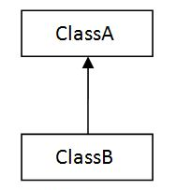
Single Inheritance
When a class inherits another class, it is known as a single inheritance.

Slide 5
Single Inheritance
Animal
eat()
Dog
bark()
eat()

Slide 6
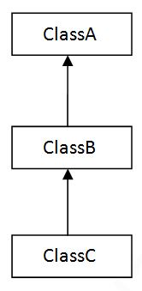
Multilevel Inheritance
When there is a chain of inheritance, it is known as multilevel inheritance.

Slide 7
Multilevel Inheritance
Animal
eat()
extends
Dog
bark()
eat()
extends
BabyDog
bark()
eat()
weep()

Slide 8
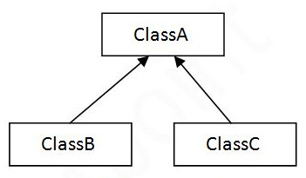
Hierarchical Inheritance
When two or more classes inherit a single class, it is known as hierarchical inheritance.

Slide 9
Hierarchical Inheritance
Bird
eat()
extends
extends
Penguin
Parrot
eat()
swim()
eat()
fly()

Slide 10
Multiple Inheritance
When a child class inherits multiple parent classes, it is known as multiple inheritance.

Slide 11
Multiple Inheritance
Animal
eat()
extends
Fish
Bird
swim()
fly()
Penguin
swim()
eat()
fly()

Slide 12
Polymorphism (Many Forms)
It is a concept by which we can perform a single action in different ways.
The same method name with
different definitions
(signatures) being used for
different forms.
Polygon

Slide 13
class Parrot: def fly(self): print("Parrot can fly") def swim(self): print("Parrot can't swim") class Penguin: def fly(self): print("Penguin can't fly") def swim(self): print("Penguin can swim") #interfaces def test_fly(bird): bird.fly() def test_swim(bird): bird.swim() pen = Penguin() # chox is an instance object from class Penguin() par = Parrot() # par is an instance object from class Par() test_fly(pen) # function call/invocation test_swim(pen) # function call/invocation test_fly(par) # function call/invocation test_swim(par) # function call/invocation

